Slide 1

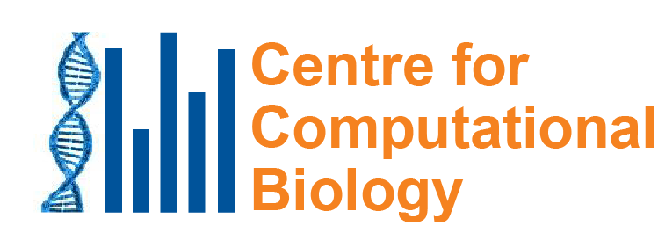
Mutational signatures: What caused the mutations in these cancers? Why do we care?
Steven G Rozen
steverozen@gmail.com
Duke-NUS Medical School, Singapore
InCoB 202
19th International Conference on Bioinformatics
Virtual meeting
2020 Nov 28 (35 min)
Notes:
25 minute talk

Slide 2
Outline
What are mutational signatures and what are they good for?
Computational analysis of mutational signatures – state of the art
Important questions in mutational signature analysis
Summary and next steps

Slide 3
What are mutational signatures and what are they good for? Example: Aristolochic acid

Slide 4
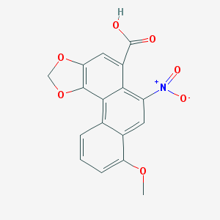
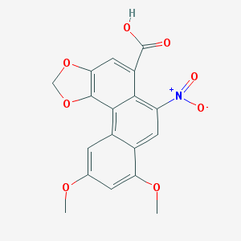
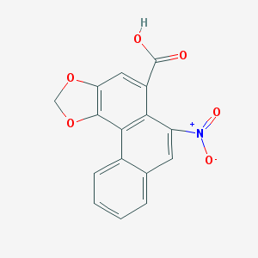
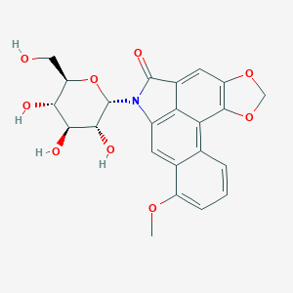
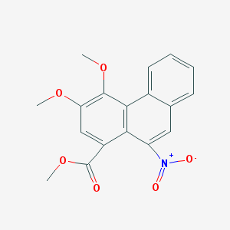
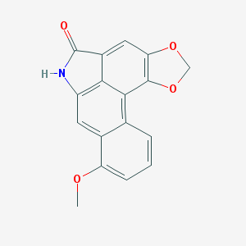
Aristolochic acids and relatives “AA”
Aristolochic acid I
Aristolochic acid II
Aristolochic acid IV
We will call them all “AA”
Aristolochic acid I studied intensively
Others very little
Aristolactam I, proximal mutagen
Aristolactam-N-beta-D-glycoside
Ariskanin A
Aristolochic acids (AAI – most studied, also AAII, AAIV, in many 关木通)

Slide 5
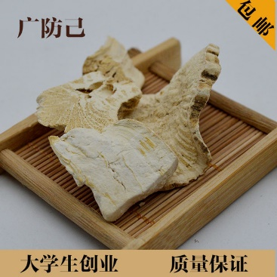
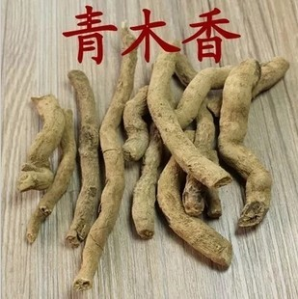
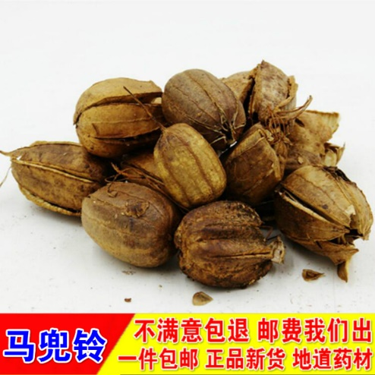
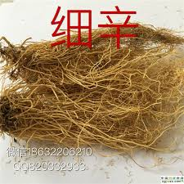
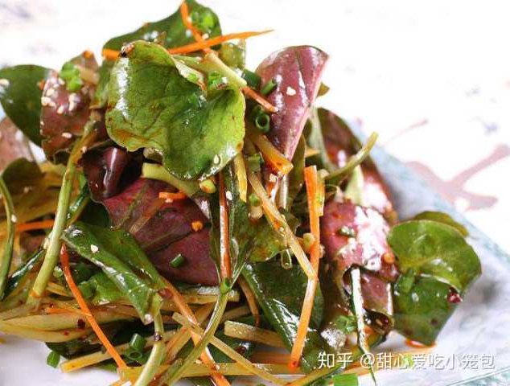
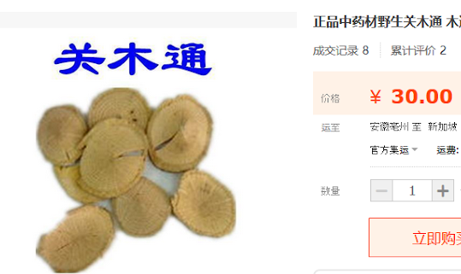
Plants with AA widely used as herbal medicine
(Occurs naturally in these plants)
Plants in Aristolochia and Asarum groups (genera), and perhaps other groups
鱼腥草

Slide 6
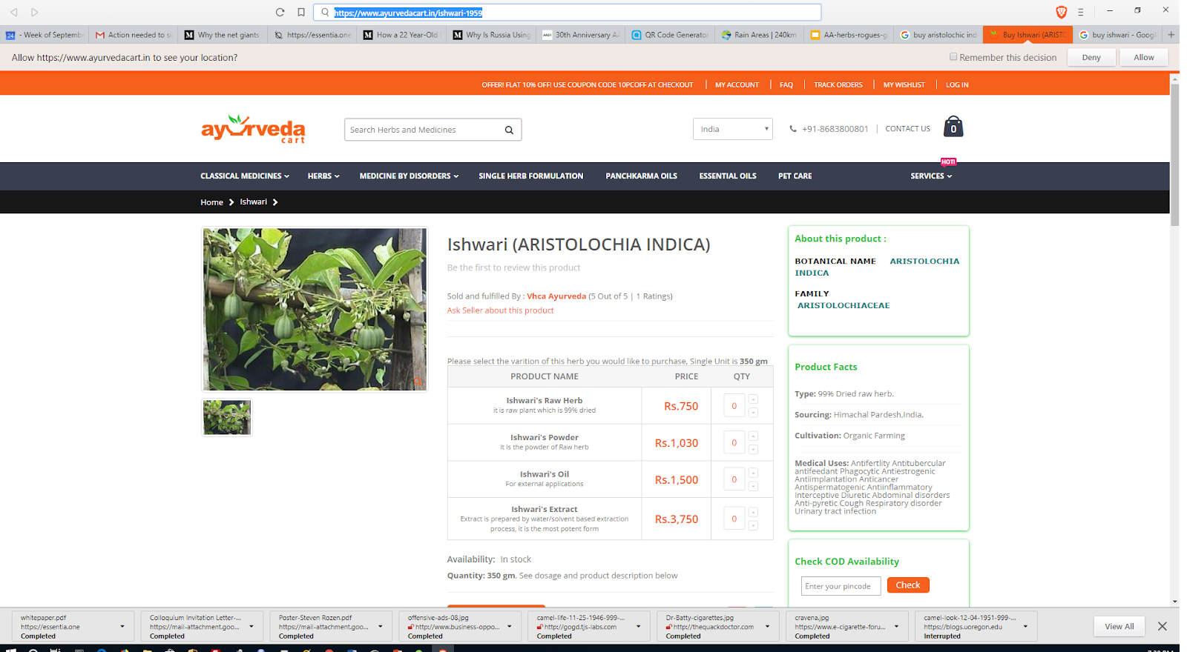
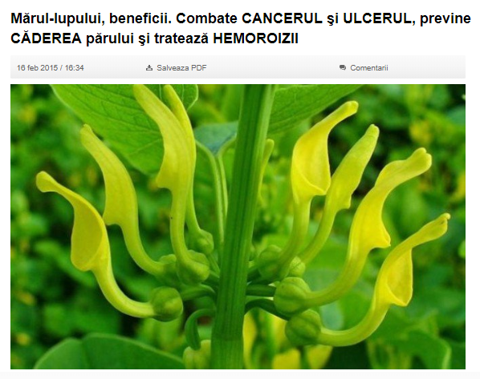
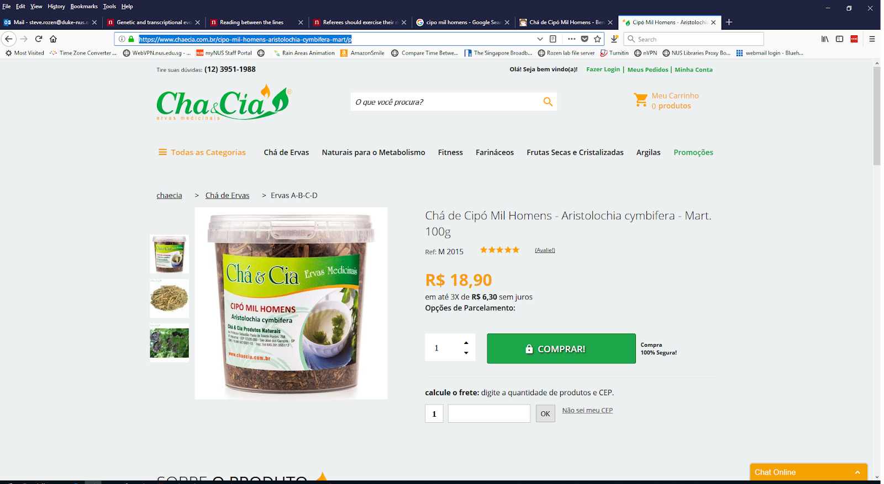
Not just Chinese herbal medicine
Romania
India
Aristolochia indica
Brazil
Aristolochia clematitis
Combats cancer, ulcers, prevents hair loss and hemorrhoids
Aristolochia cymbifera

Slide 7
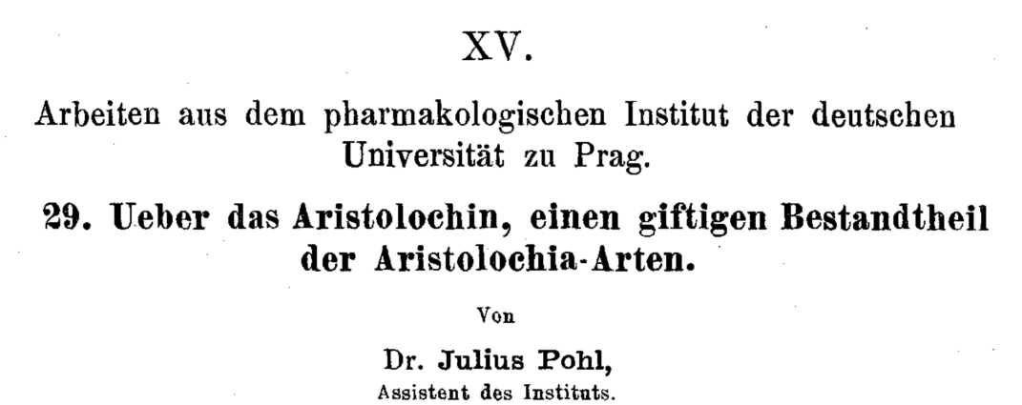
AA: well-known nephrotoxins
1891

Slide 8
1990s: AA emerges as a human health problem
~100 young women with end stage kidney disease
Single weight-loss clinic in Europe
汉防己, hàn fáng jǐ replaced by 广防己, guǎng fáng jǐ
Notes:
Dose: (Cosyns 2003; Nortier et al. 2000)
Adducts: Nortier et al., 2000

Slide 9
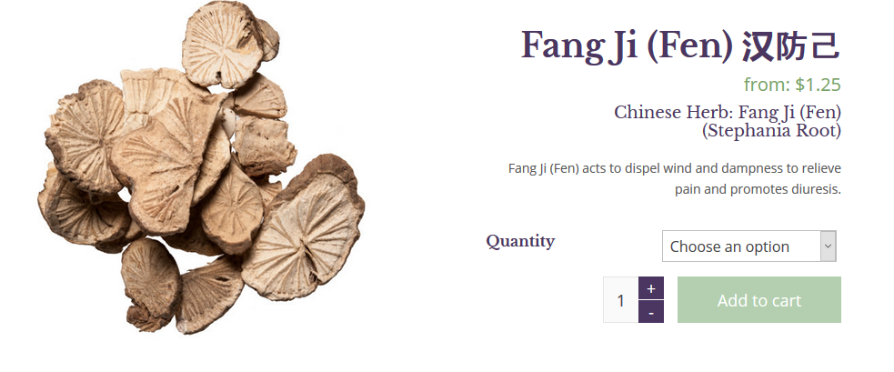
漢防己 / 汉防己, hàn fáng jǐ (genus Stephania – no AA)

Slide 10
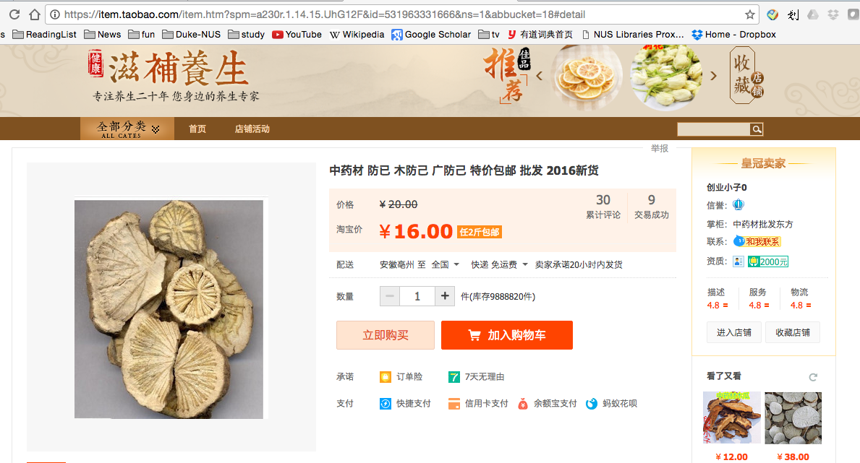
廣防己/广防己, guǎng fáng jǐ (genus Aristolochia – has AA)
Notes:
Total of 0.5 g over average of 13 months
AA adducts

Slide 11
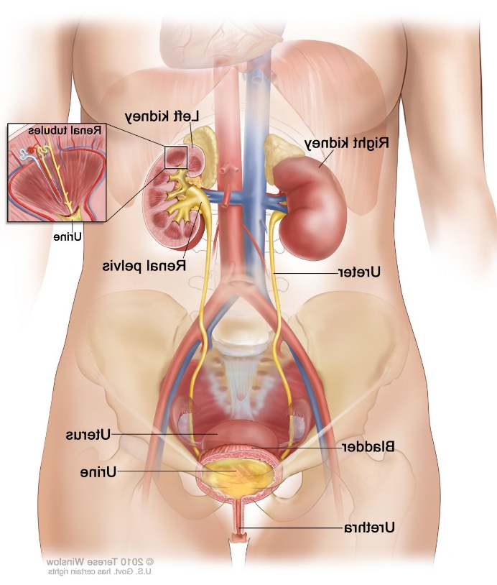
Many of the AA-kidney-failure victims developed upper tract urothelial cancer
(Nortier et al., 2000, NEJM)

Slide 12
Quick review: somatic mutations
Every time our cells divide, mutations arise
Mutations not present in the fertilized egg are somatic mutations
Focus on mutational signatures of somatic mutations

Slide 13
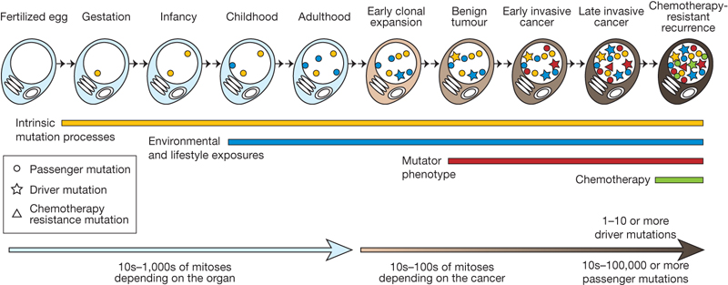
We detect somatic mutations by DNA sequencing normal cells and tumour cells
Normal
Normal
…ACGTCCTAGTCAAAATCGAGCC…

Slide 14
We detect somatic mutations by DNA sequencing normal cells and tumour cells
Normal
Tumour
…ACGTCCTAGTCAAAATCGAGCC…
…ACGTCCTAGTCTAAATCGAGCC…

Slide 15
We detect somatic mutations by DNA sequencing normal cells and tumour cells
We look for the variants found only in the tumor
Normal
Tumour
…ACGTCCTAGTCAAAATCGAGCC…
…ACGTCCTAGTCTAAATCGAGCC…
Somatic mutation from A > T
CAA > CTA trinucleotide context: information in neighboring bases

Slide 16
We look at all mutations (most are not causing the cancer; they are innocent bystanders)
We want to know: what mutated (changed) the DNA?
?

Slide 17
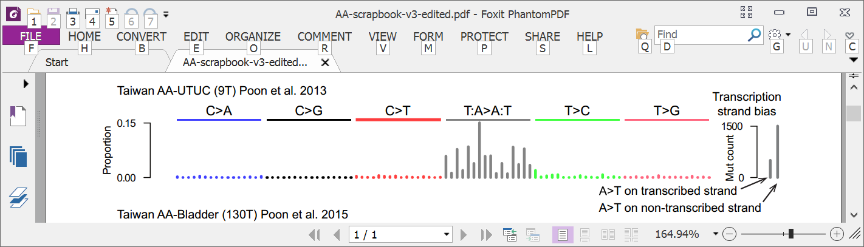
Mutational signature in an AA-exposed upper tract urothelial carcinoma
More
mutations
Each bar represents the total number of single nucleotide substitutions in a particular trinucleotide context
Highest bar represents the number of CAG to CTG mutations across the entire genome
The higher the bar, the more CAG to CTG mutations
Poon et al, Science Translational Medicine, 2013

Slide 18
Mutational signature in an AA-exposed upper tract urothelial carcinoma
More
mutations
AAG > ATG mutations
Not as many
Highest bar represents the number of CAG to CTG mutations across the entire genome
The higher the bar, the more CAG to CTG mutations
Mutations from C to A, C to G, C to T
Almost none
Poon et al, Science Translational Medicine, 2013

Slide 19
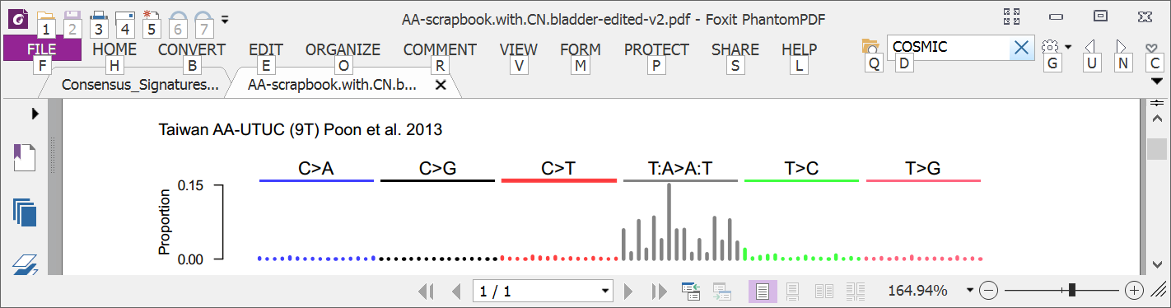
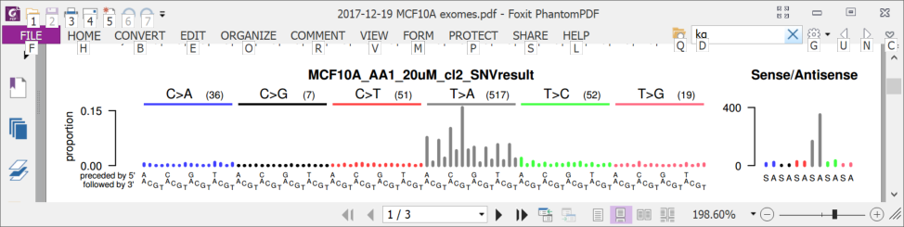
6 years ago (2013): AA in upper tract urothelial cancer and cell lines
Upper tract urothelial
AA exposed cell line
Poon et al., 2013, Hoang et al. 2013

Slide 20
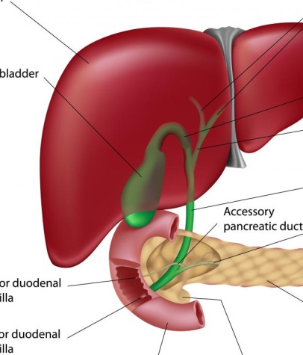
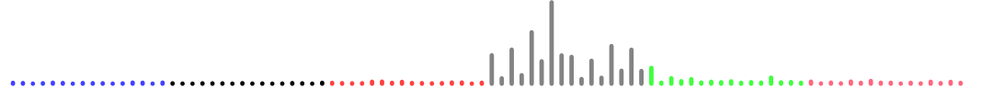
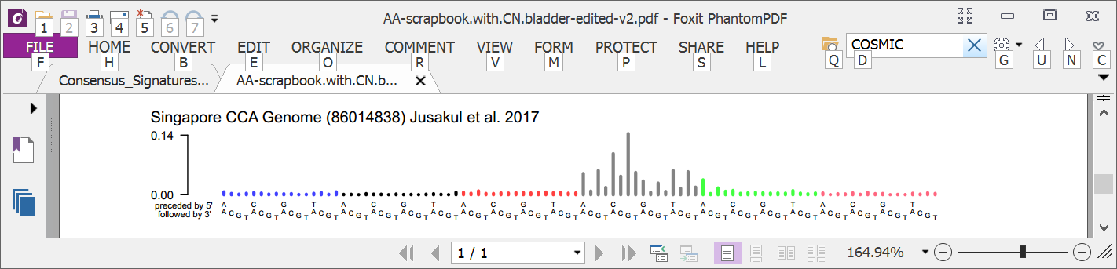
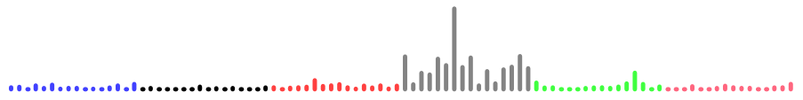
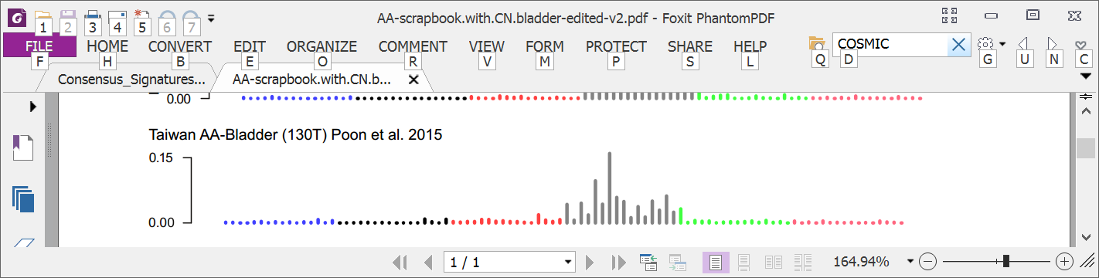
3 years ago: AA in multiple tumor types
Liver
Bile duct
Kidney
Upper tract urothelial
Bladder
Poon et al., 2013 and subsequent data (liver - hepatocellular carcinoma [HCC])
Zou et al., 2015, Jusakul et al., 2017 (bile duct carcinoma)
Scelo et al., 2014, Jelakovic et al., 2014 (kidney/renal cell carcinoma)
Poon et al., 2013, Hoang et al., 2013, many others (upper tract urothelial carcinoma)
Poon et al., 2015, others (bladder urothelial carcinoma)

Slide 21

Taiwan a known hotspot for AA exposure AA in liver cancer not studied
Chen, …., Grollman, PNAS, 2012
Map created by Freepik

Slide 22
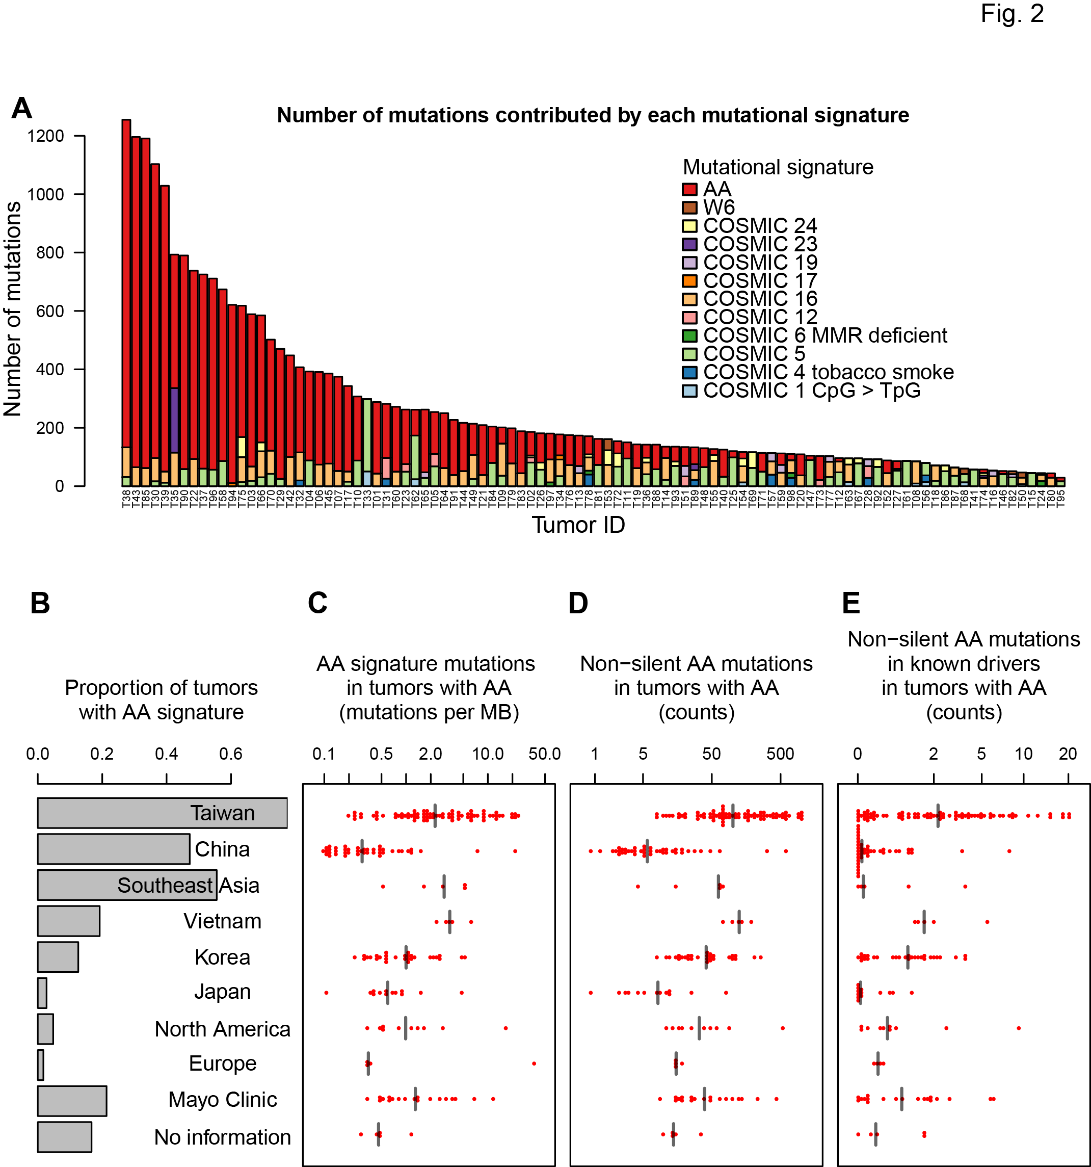
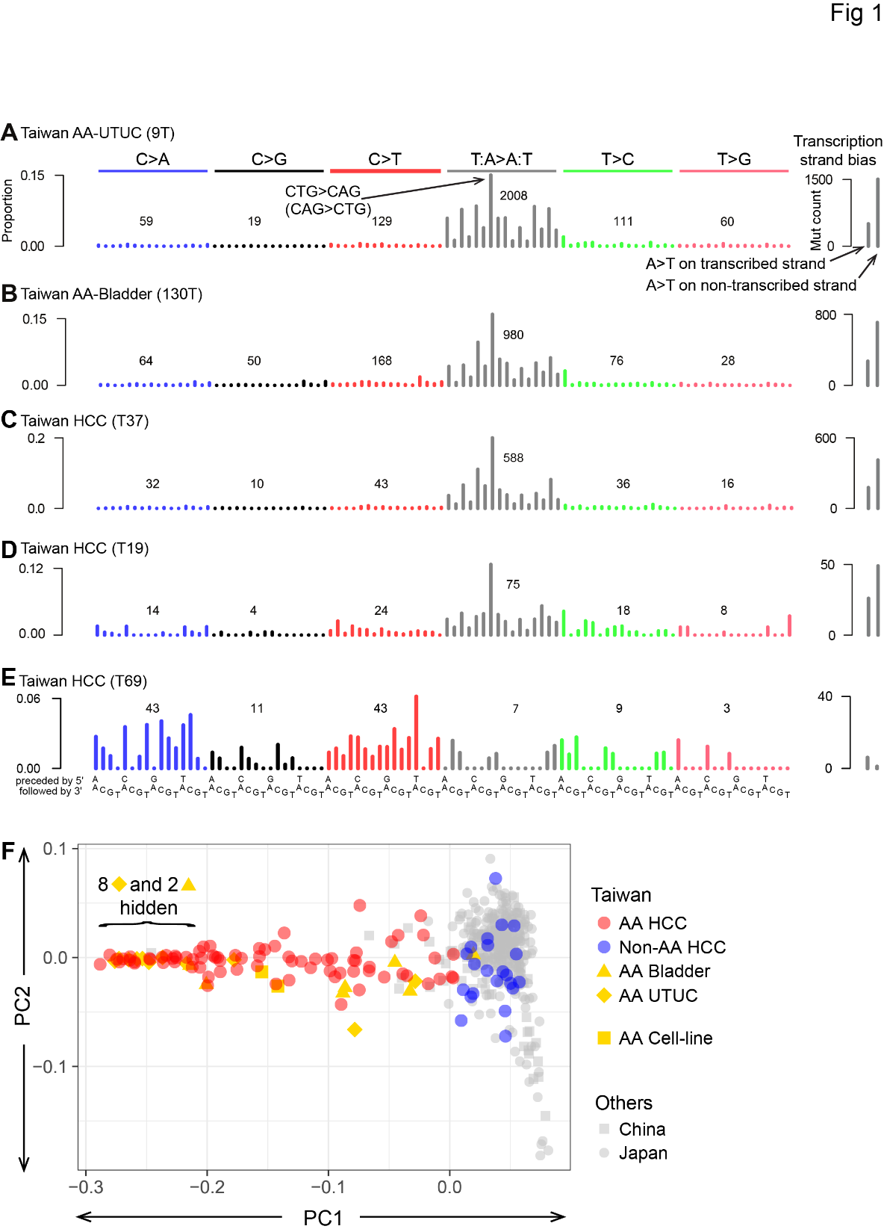
78% of Taiwan liver cancers (HCCs) had the AA signature
Ng, Poon, et al., Oct 2017 DOI: 10.1126/scitranslmed.aan6446

Slide 23
How extensive is AA exposure in > 1,600 liver cancers around the world?

Slide 24
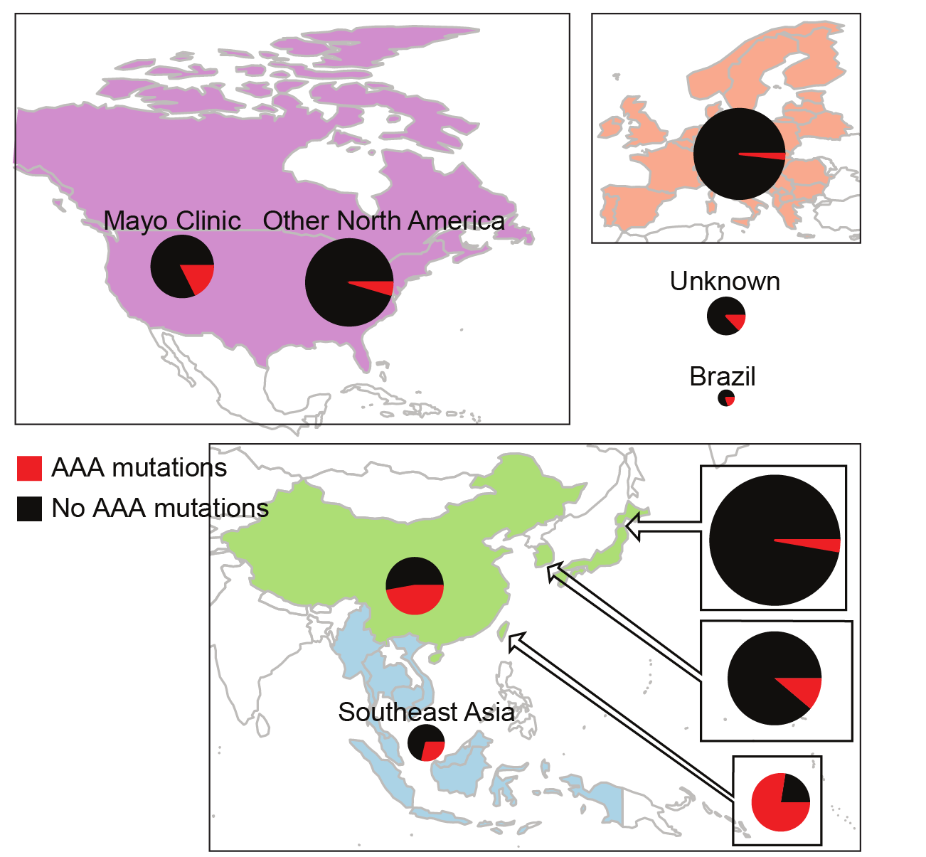
Prevalent AA exposure across > 1,600 liver cancers
“Asian” patients with no “country” – Overseas patients?
~50/100 (~50%) combined HCC and bile duct cancer in China
12/47 (25%) in Qidong (aflatoxin a major competing hazard)
Ng, Poon, et al., Oct 2017 DOI: 10.1126/stranslmed.aan6446 and subsequent publications; Zhang et al., 2017, Gastroenterology, 10.1053/j.gastro.2017.03.024; Xue et al., 2019, Cancer Cell,10.1016/j.ccell.2019.04.007

Slide 25
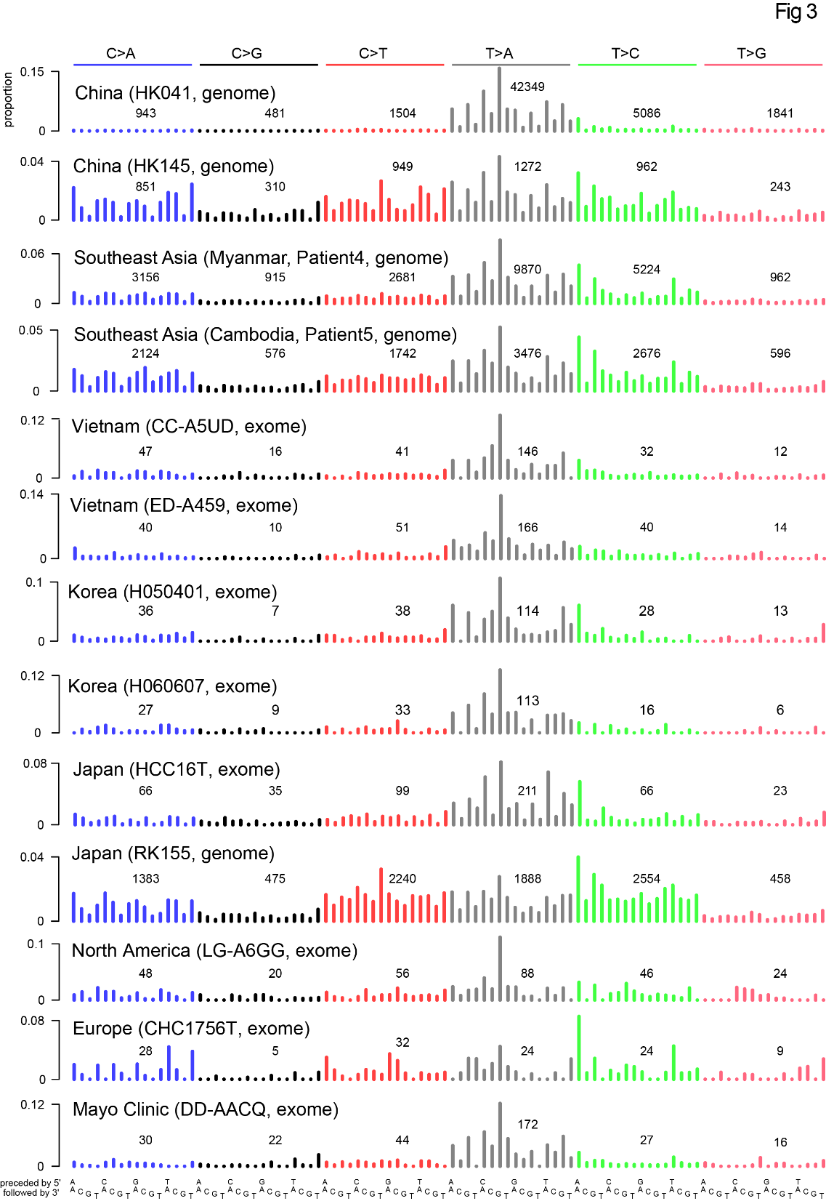

Slide 26
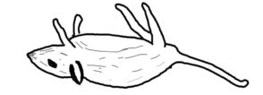
AA can cause liver cancer
Evidence…
Known mutagen and urinary tract carcinogen
“Asian” patients with no “country” – Overseas patients?
Multiple known cancer driver genes with AA mutations
Proportion of AA exposed liver cancers in Taiwan (78%) much greater than proportion of population exposed to AA herbs, (33%)
AA adducts liver tissue of HCC patients
~50/100 (~50%) combined HCC and bile duct cancer in China
Linear relationship between AA dose and risk of liver cancer in hepatitis-B-infected and hepatitis-C-infected patients
AA causes liver cancer in mice
12/47 (25%) in Qidong (aflatoxin a major competing hazard)
Ng, Poon, et al., Oct 2017 DOI: 10.1126/stranslmed.aan6446 and subsequent publications; Zhang et al., 2017, Gastroenterology, 10.1053/j.gastro.2017.03.024; Xue et al., 2019, Cancer Cell,10.1016/j.ccell.2019.04.007，Hsieh et al., 2008, 10.1186/1749-8546-3-13) Chen et al., 2018 (International Journal of Cancer, 10.1002/ijc.31544) Chen et al., 2019 (Cancer Epidemiology, Biomarkers & Prevention, 10.1158/1055-9965.EPI-19-0023），Lu et al. 2019 Hepatology, 2019, 10.1002/hep.30863

Slide 27
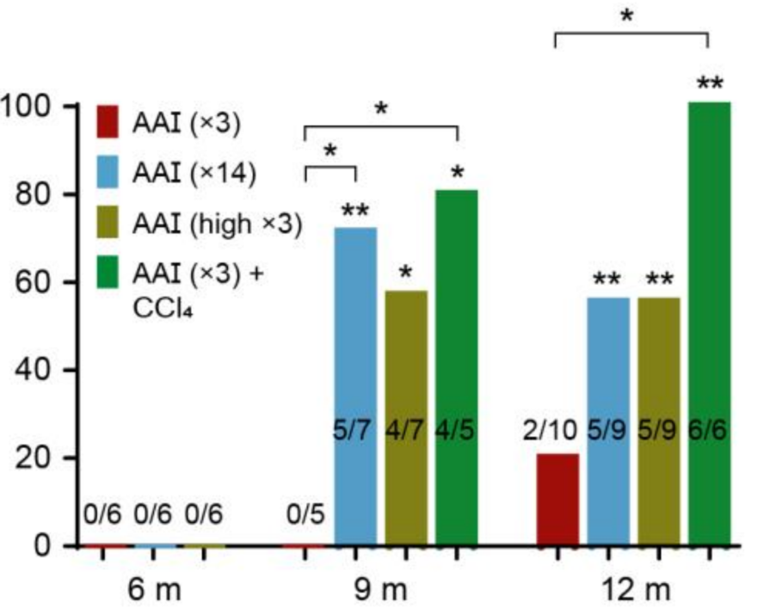
AA causes liver cancer in mice
The mutational features of aristolochic acid-induced mouse and human liver cancers
Zhao-Ning Lu, Qing Luo, Li-Nan Zhao,
Yi Shi, Na Wang, Lan Wang,
Ze-Guang Han
Hepatology, 2019, 10.1002/hep.30863
** or * = significant versus untreated
Tumor incidence (%)
Months after exposure
AAI @ 2.5 mg/kg or 5 mg/kg (“high”)
Notes:
3 X AAI = 7.5 14 X AAI = 35 high X 3= 15

Slide 28
Computational analysis of mutational signatures: State of the art

Slide 29
Important questions in mutational signature analysis

Slide 30
Important questions
What signature profiles are present in a large set of mutational spectra? (already discussed)
What signatures contributed to a single mutational spectrum? (or a small set of related spectra)
What is the evidence that single signature (or group of signatures) contributed to a spectrum?
Is a spectrum adequately explained by the activities of known signatures? I.e., does my spectrum, or a group of related spectra contain a novel signature?

Slide 31
Important questions
What signature profiles are present in a large set of mutational spectra? (already discussed)
What signatures contributed to a single mutational spectrum? (or a small set of related spectra)
What is the evidence that single signature (or group of signatures) contributed to a spectrum?
Is a spectrum adequately explained by the activities of known signatures? I.e., does my spectrum, or a group of related spectra contain a novel signature?

Slide 32

Simply optimize coefficients of each signature to minimize reconstruction error (45 signatures assigned)

Slide 33
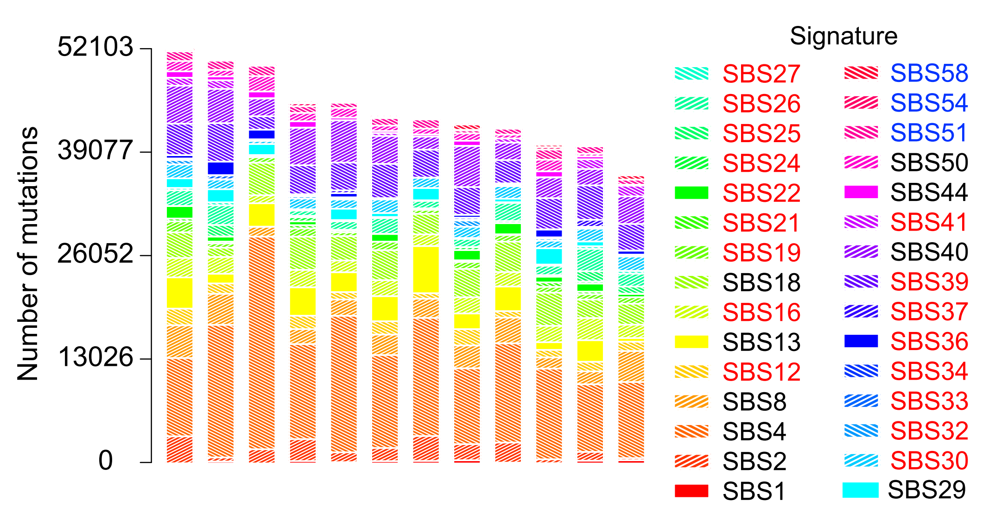
Impose some sparsity by requiring minimum number of mutations (30 signatures assigned)

Slide 34
Summary and next steps

Slide 35
Acknowledgements
Chang Gung Memorial Hospital
Sen-Yung Hsieh (谢森永)
Hao-Yi Huang
Ming-Chin Yu
Po-Huang Lee
Jacob See-Tong Pang
Singapore (Duke NUS, National Cancer Centre Singapore, and Johns Hopkins Singapore)
Arnoud Boot
Alvin NG Wei Tian (黄伟添)
Song Ling POON
Mi Ni HUANG
Jing Quan LIM
Nanhai Jiang
Shenli Zhang
Szu-Chi Ho
Willie Yu
Yuka Suzuki
Cedric C. Y. Ng
Patrick Tan
Bin Tean TEH
Alex Chang
Funding
Singapore National Medical Research Council
Singapore Ministry of Health via the Duke-NUS Signature Research Programmes
Chang Gung Medical Foundation

Slide 36
AA exposure is widespread in East Asia and causes liver cancer
More research is needed!
Thank you
steverozen@gmail.com
Main Taiwan HCC paper: https://tinyurl.com/aa-liver-cancer

Slide 37
The remainder are “backup slides”

Slide 38
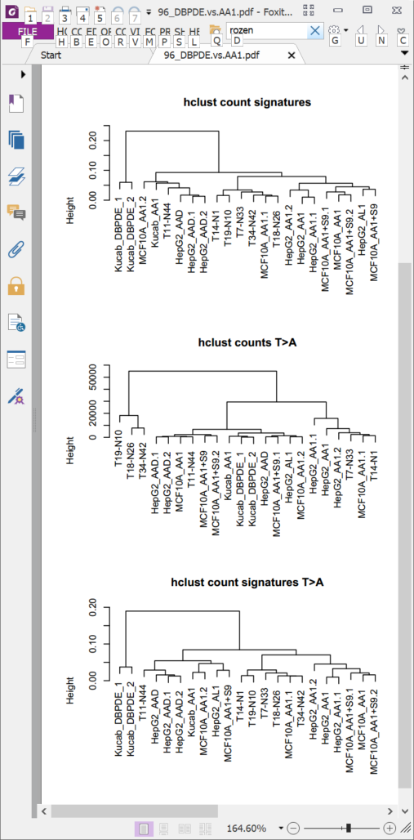
DBPDE signature is slightly different (Dibenzo(a,l)pyrene-11,12-dihydrodiol-13,14-epoxide, anti-(+/-)-, CAS 153926-04-6 )
Clustered by Euclidian distance of all single base substituitons in trinucleotide context
Clustered by Euclidian distance of A:T > T:A substituitons in trinucleotide context

Slide 39
Table S6. Drivers identified by MutSigCV or 20/20+ in 98 Taiwan HCCs.
Gene | Proportion of Taiwan HCCs with mutation | Classification in Cancer Gene Census | Notes | Proportion with mutations in TCGA 2017
TP53 | 0.54 | TSG | Commonly mutated in HCC | 0.31
CTNNB1 | 0.24 | oncogene | Commonly mutated in HCC | 0.27
ALB | 0.21 |  | Commonly mutated in HCC, status as driver controversial | 0.13
AXIN1 | 0.17 | TSG | Commonly mutated in HCC | 0.08
DOCK8 | 0.11 |  | Not expressed in liver or liver cancer (http://www.proteinatlas.org/ENSG00000107099-DOCK8/cancer); not observed in any other HCC genomic study | NR
BRD7 | 0.09 |  | Observed in Totoki et al., 2014 , Fujimoto et al., 2016 | NR
ARID2 | 0.09 | TSG | Observed in multiple other HCC genomic studies | 0.05
RPS6KA3 | 0.08 |  | Observed in multiple other HCC genomic studies | 0.04
IRF2 | 0.06 |  | Reported as an HCC TSG in Guichard et al., 2012 | NR
RAG1 | 0.06 |  | Activation of immunoglobulin V-D-J recombination.; not likely to have a role in hepatocytes or liver cancer | NR
RB1 | 0.06 | TSG | Observed in multiple other HCC genomic studies | 0.04
PBRM1 | 0.05 | TSG | Observed in multiple other HCC genomic studies | NR

Slide 40
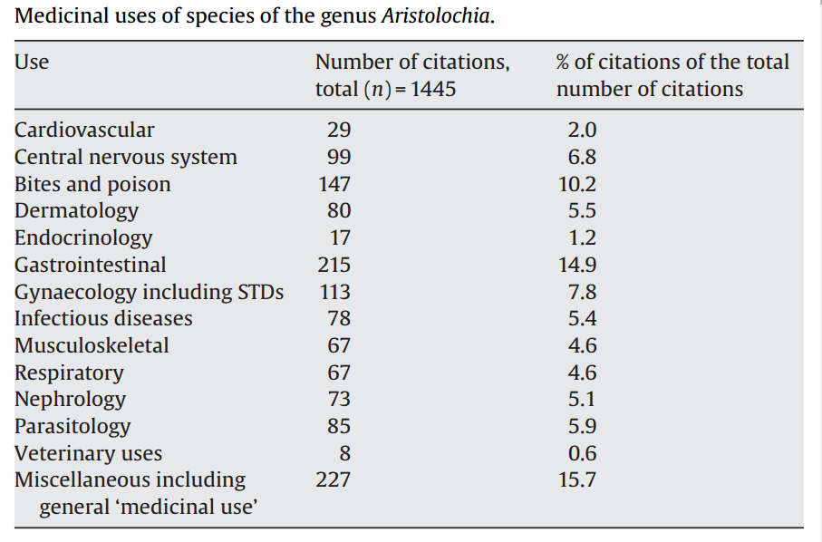
M. Heinrich et al 2009
doi:10.1016/j.jep.2009.05.028

Slide 41
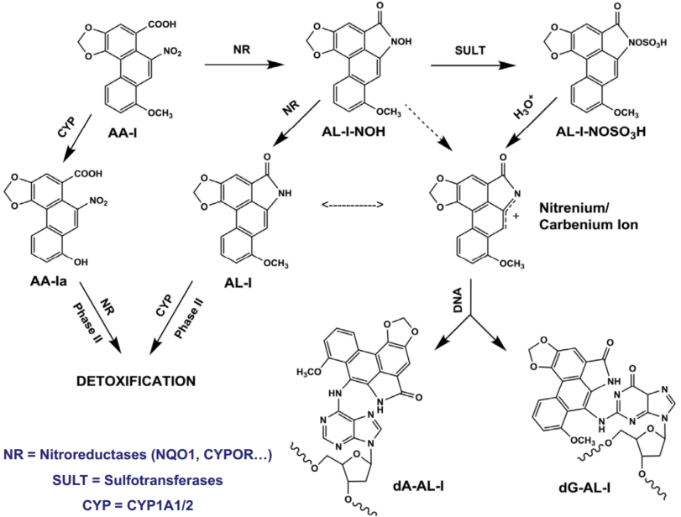
Proposed AAI metabolism, from Viktoriya Sidorenko slide deck “Liver-kidney organs-on-a-chip reveal distant site for bioactivation of human carcinogen”

Slide 42
Conceptual context
Statistical and computational analysis
Experimental study of causes of mutational signatures
Mutational Signatures
New understanding
of DNA damage and repair
Molecular cancer epidemiology
How do mutations cause cancer?
Prevention and screening
Cancer life histories and signature-associated oncogenic pathways
Specific therapeutic opportunities

Slide 43
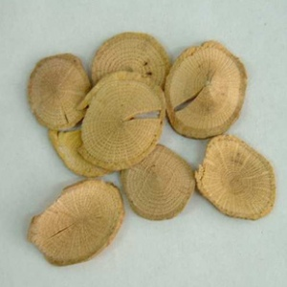
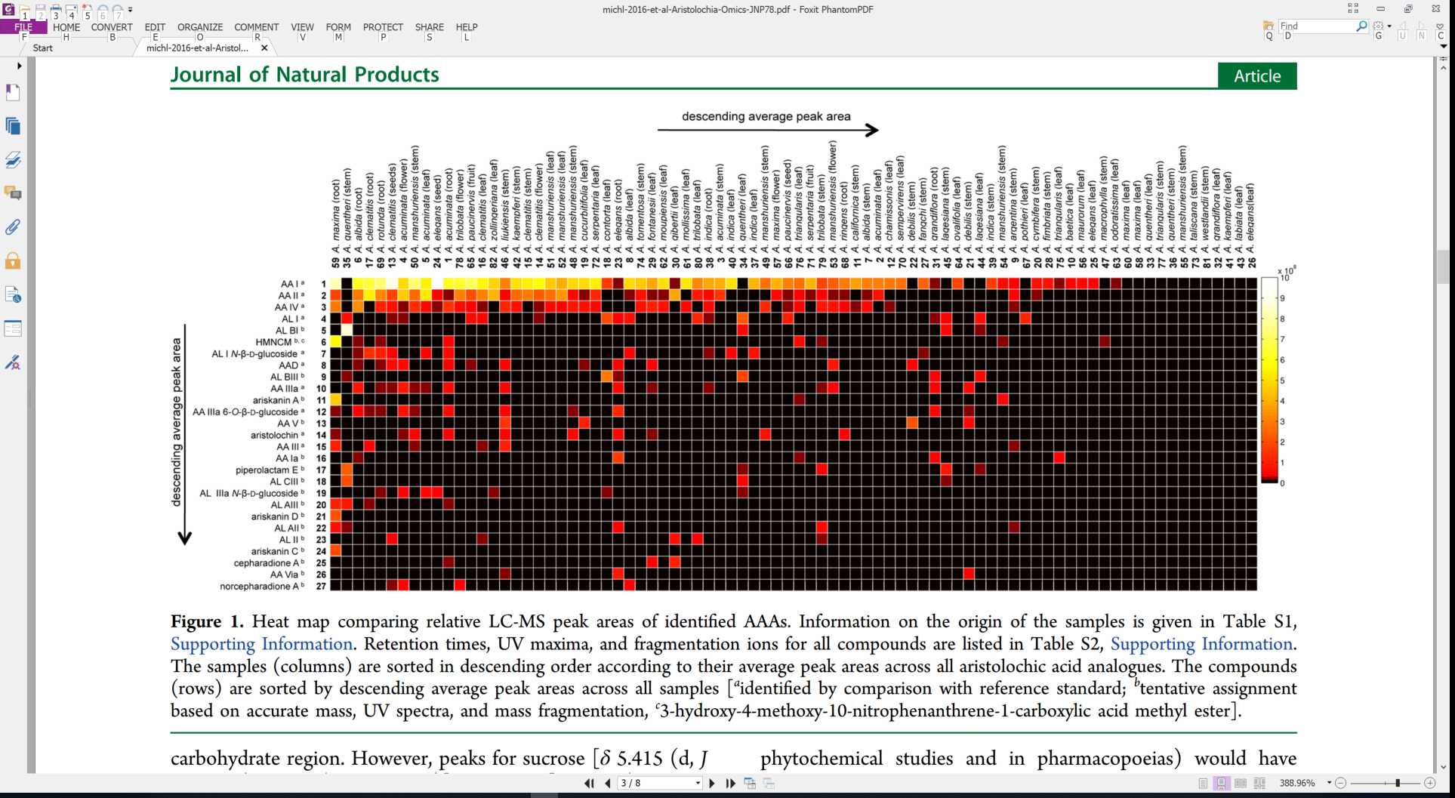
Variable and diverse AA content
Each column is a sample
关木通 guān mù tōng (stem of
Aristolochia manshuriensis)
High concentration
Each row is a different AA analog
Low concentration
Michl et al., 2015, J. Natural Products doi:10.1021/acs.jnatprod.5b00556
Notes:
https://www.e138.net/zhongyao/cai-141.html

Slide 44
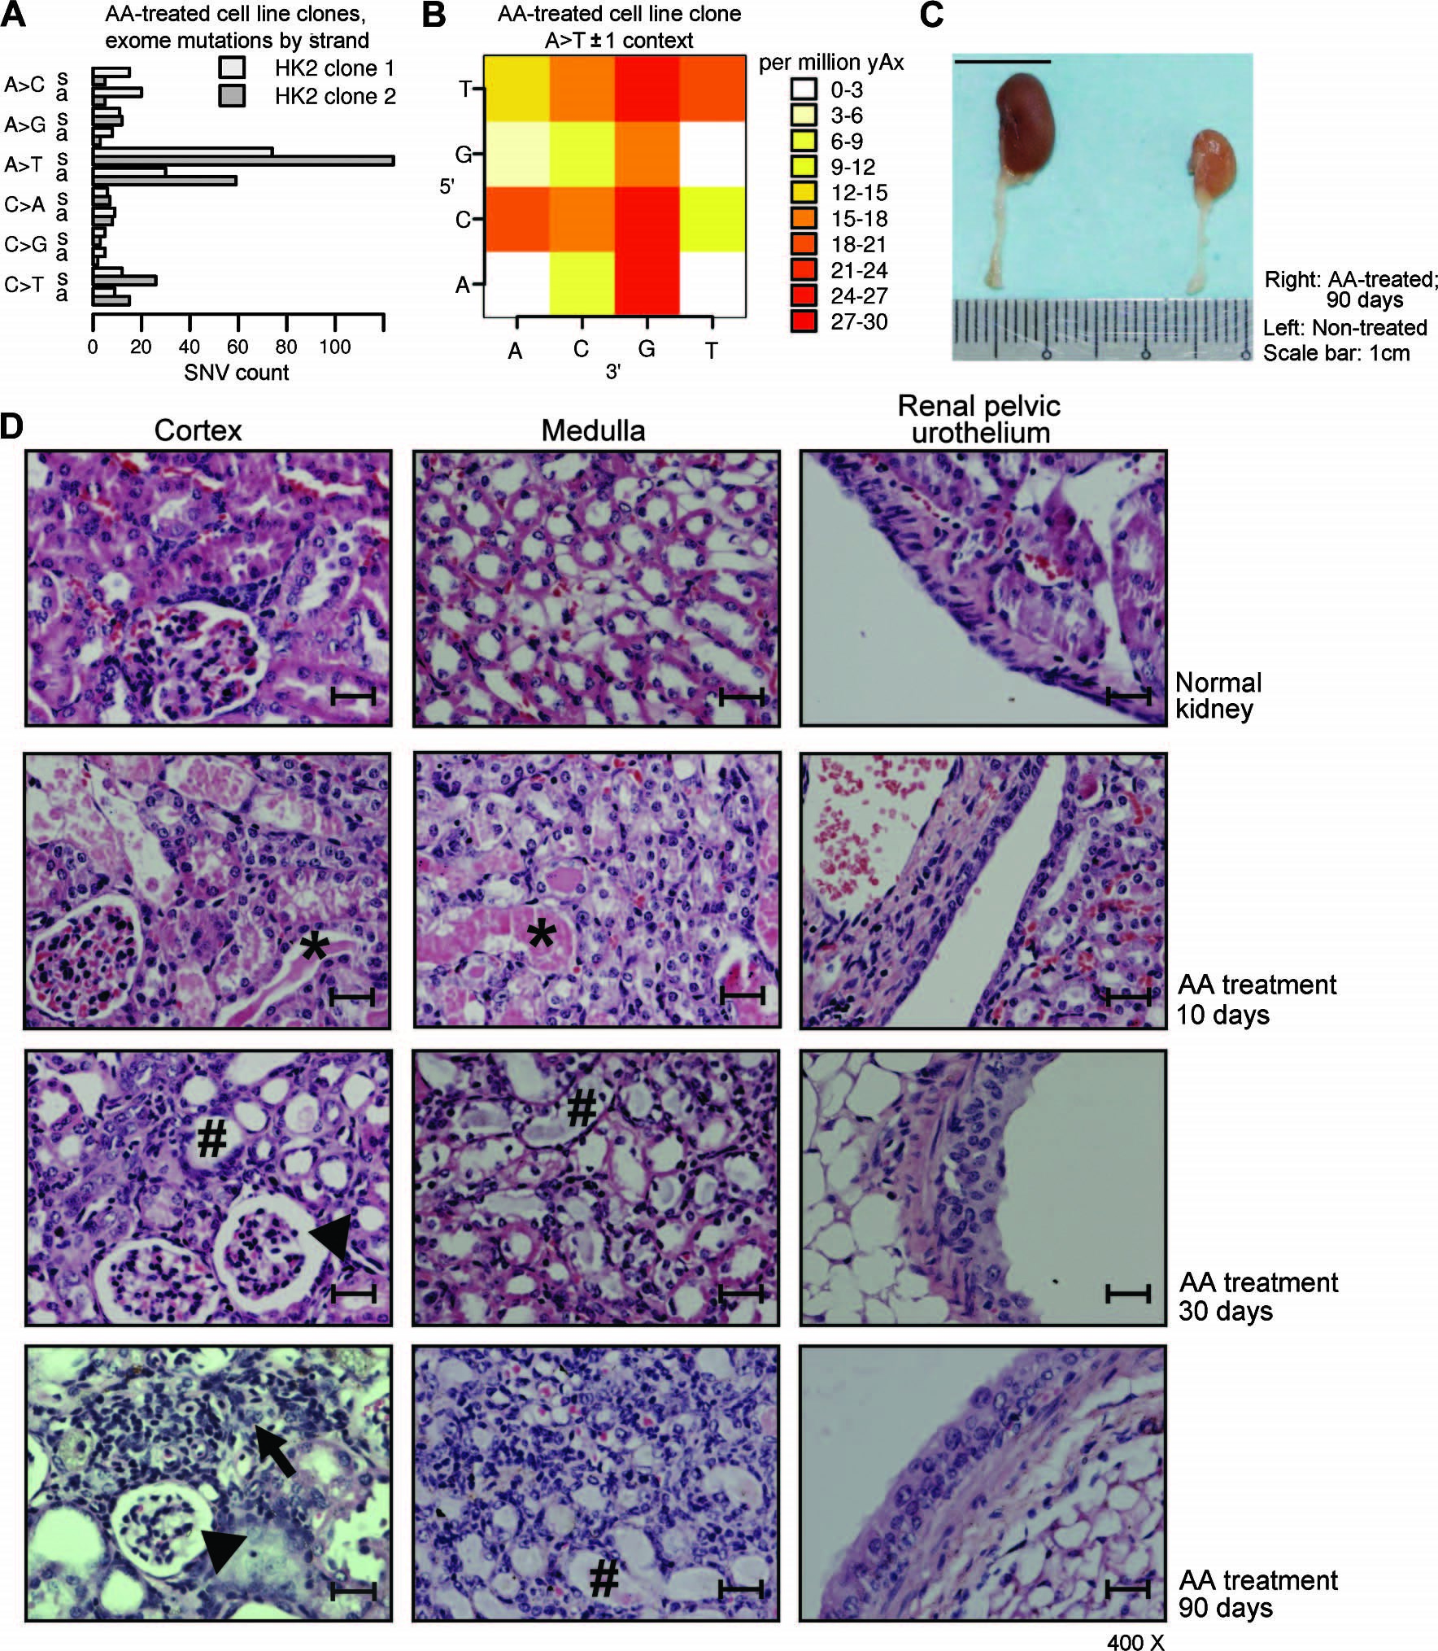
Details of kidney damage from AA
Important: Leads to cancer
Many patients with AA kidney failure develop urothelial cancer
(Nortier et al., 2000, NEJM)
Untreated
Upper tract (near kidney)
Normally rare
90 days after AA
exposure
Inflammatory infiltration
Urothelial dysplasia
Glomerulus: ischemic shrinkage
Tubule with naked basement membrane (necrotic epithelium)
Poon, 2013, doi:10.1126/scitranslmed.3006086
400X, scale bar: 25 μm
Notes:
mouse kidney (hematoxylin and eosin staining, ×400; scale bars, 25 um)
day 10,: accumulation of proteinaceous fluid within the tubules of the AA-treated kidney (*)
days 30 and 90: tubular epithelial cells were necrotic and had collapsed, leaving the tubular basement membrane naked (#). There were few signs of regeneration.
The glomeruli demonstrated ischemic shrinkage (arrowhead).
Dat 90 local inflammatory infiltration (arrow) in the interstitium,
urothelial dysplasia had developed
(50 mg/kg) for 3 days
Cosyns: intraperitoneal 0.1 mg AA/kg/day 5/7 days during 17 (N 5 5) and 21 (N 5 6)
Estimated dose in Belgium? In he *powder* it was up to 2.9 mg / g – see Identification of aristolochic acids in Chinese herbs. Lancet 1994;343:174 ??? Cannot find
From Dickman review: “The maximal daily dose of AA ingested by the cluster of Belgian women is estimated to be 0.025 mg kg1 body weight daily for an average of 13 months (Cosyns 2003; Nortier et al. 2000), “

Slide 46
Number of AA mutations was variable
AA signature mutations
in tumours with the signature
(mutations per megabase)
2.26 AA mutations / Mb
Taiwan
Mainland China
Other SE Asia
Vietnam
Korea
Japan
North America
Europe
Mayo Clinic
No information
0.29 AA mutations / Mb

Slide 47
Number of AA-mutated cancer driver genes was variable
Nevertheless…
Overall, many tumors had AA mutations in known cancer driver genes
AA signature mutations
in tumours in known driver genes
(counts)
Taiwan
Mainland China
Other SE Asia
Vietnam
Korea
Japan
North America
Europe
Mayo Clinic
No information
Taiwan: 2 AA mutations in known cancer drivers
Mainland: only a few with 1 AA mutation in known cancer driver gene

Slide 48
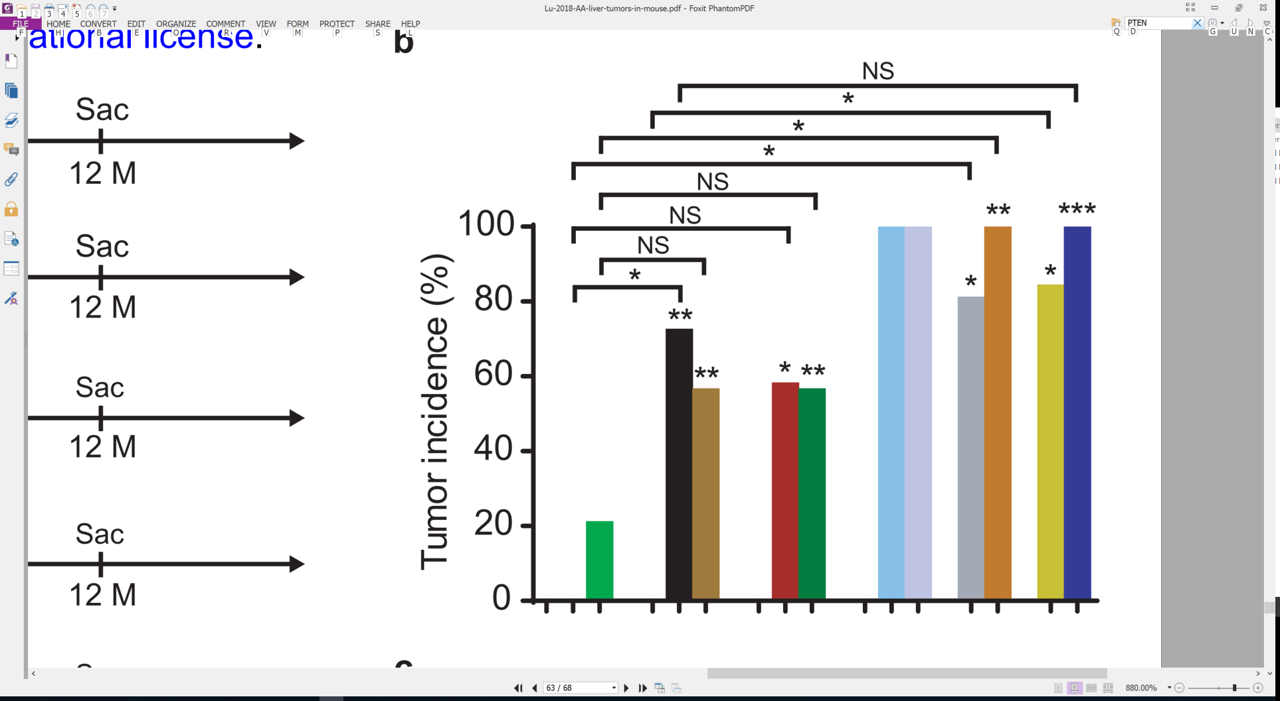
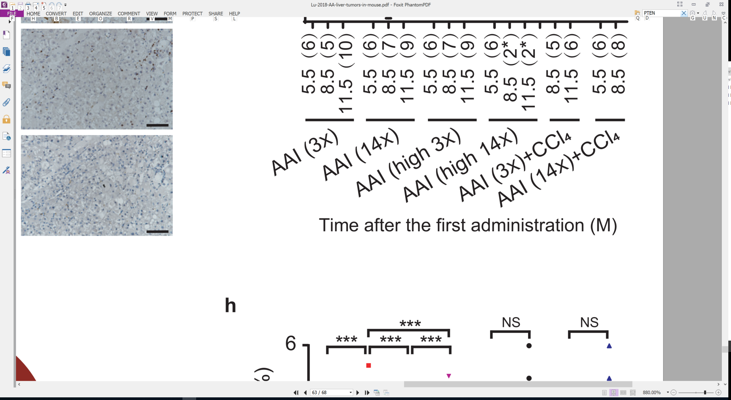
AA causes liver cancer in mice
** or * indicate
significant
versus untreated
The mutational features of aristolochic acid-induced mouse and human liver cancers
Zhao-Ning Lu, Qing Luo, Li-Nan Zhao, Yi Shi, Xian-Bin Su,
Ze-Guang Han
doi: https://doi.org/10.1101/507301
Dec 28, 2018
Months after exposure
7.5 15 35 70
Total dose (mg/kg)
(Re-drawn from Lu et al.)

Slide 49
Mutational signature in an AA-exposed upper tract urothelial carcinoma
More
mutations
More
mutations
AA exposed cell line
Poon et al, Science Translational Medicine, 2013
Notes:
Cel line: MCF10A_AA1_20uM_cl2_SNVresult from Arnoud 2018 09 21

Slide 50
Outline
AA compounds in herbal medicine
AA mutational signature and urothelial cancer
AA in liver cancer
Ongoing research and summary

Slide 51
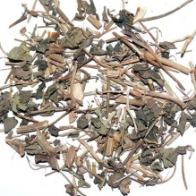
Variable and diverse AA content
Each column is a sample
天仙藤 tiān xiān téng (thin stems and leaves of Aristolochia debilis)
High concentration
Each row is a different AA analog
Low concentration
Michl et al., 2015, J. Natural Products doi:10.1021/acs.jnatprod.5b00556

Slide 52
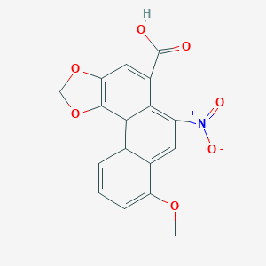
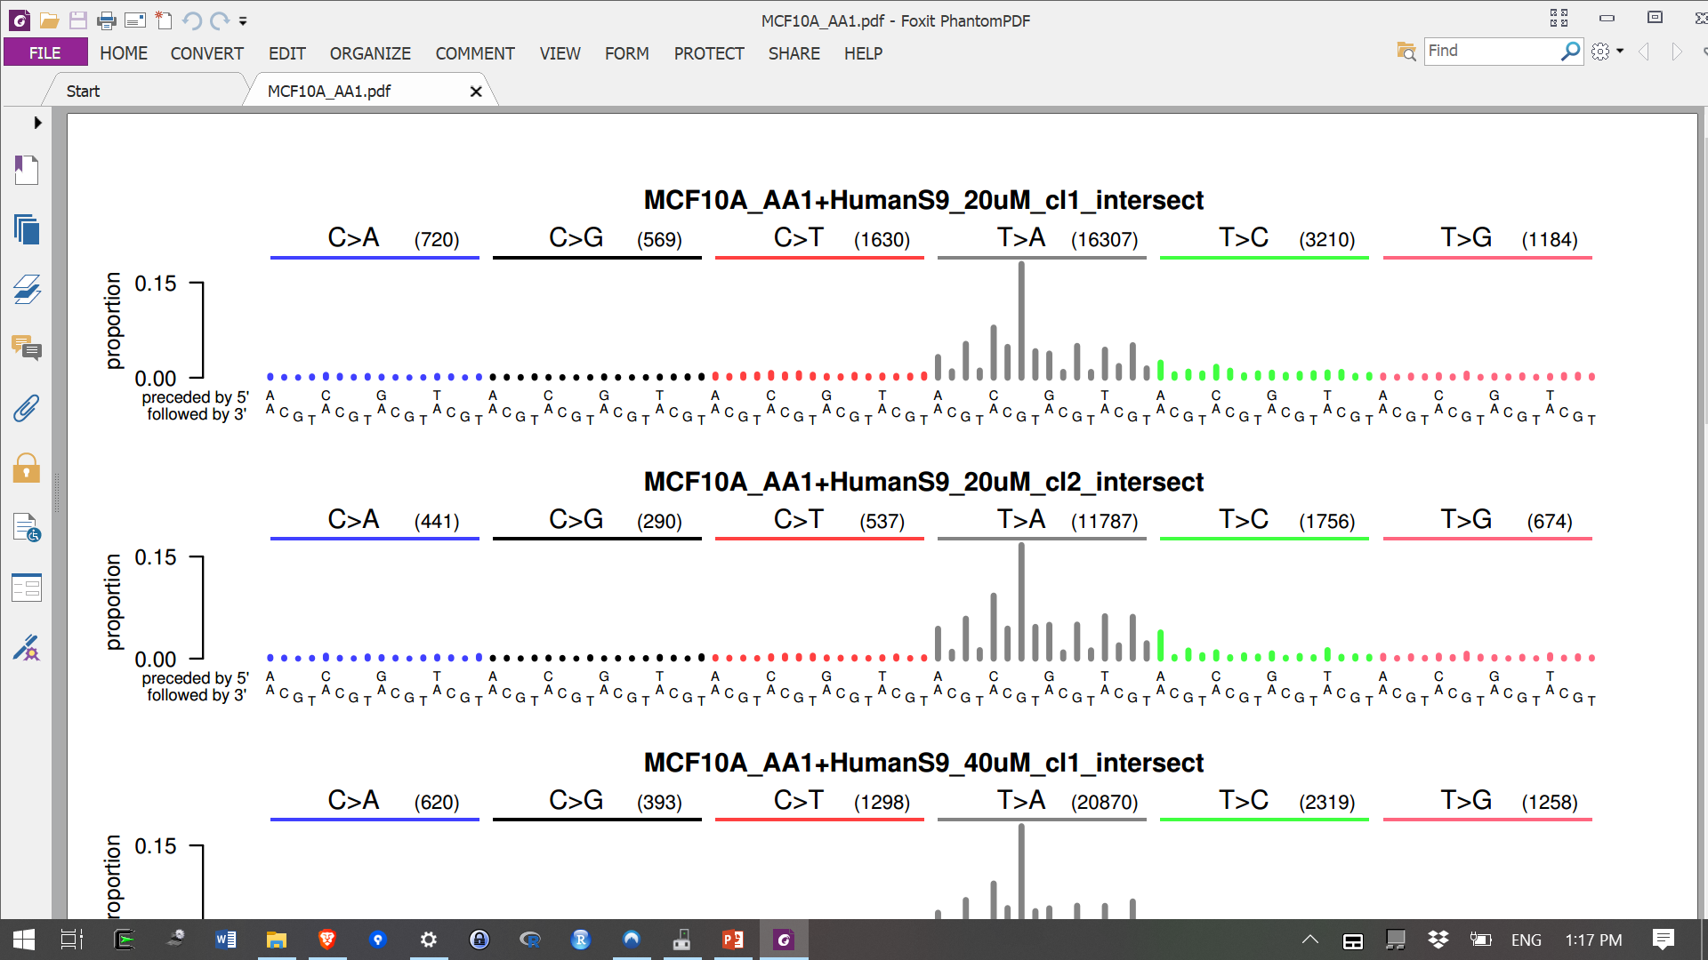
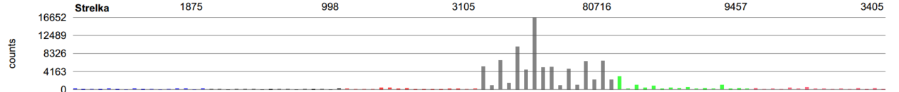
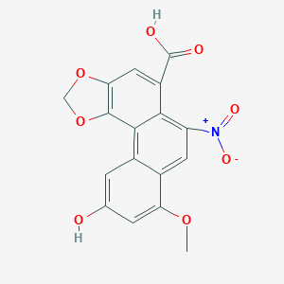
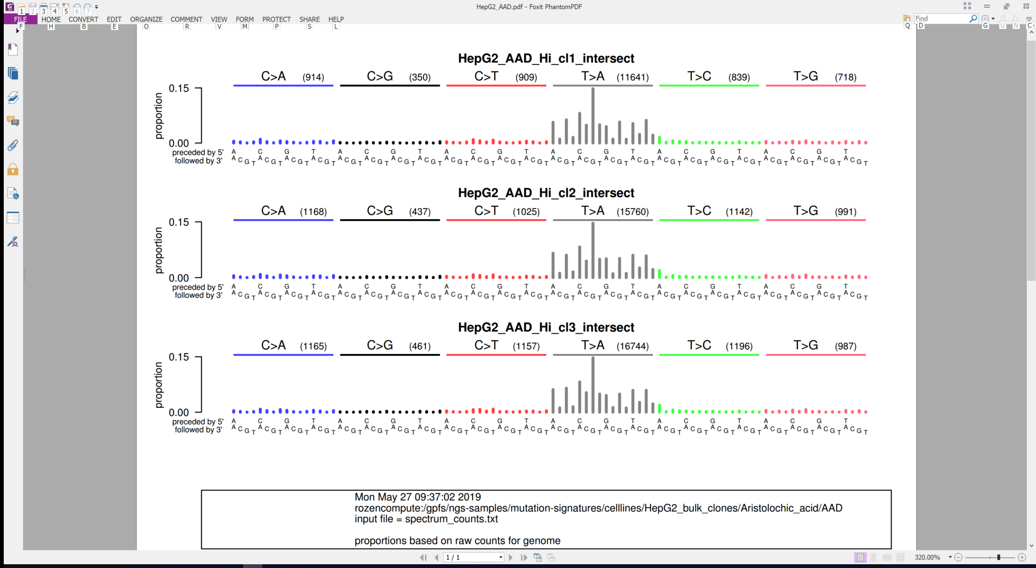
Preliminary results: Several AA related compounds have similar mutational signatures
AA I
AA I in MCF10A cells
Liver cancer
AA D
AA D in HepG2 cells
AA D in HepG2 cells (replicate)
hydroxy
methoxy

Slide 53


Preliminary results: Several AA related compounds have similar mutational signatures
AA I
AA I in MCF10A cells
Liver cancer
Aristolactam I

Slide 54


Preliminary results: Several AA related compounds have similar mutational signatures
AA I
AA I in MCF10A cells
Liver cancer
Aristolactam BII

Slide 55


More AA signatures: Double-base signatures in exposed cell lines and in tumours
AA I
Taiwan
upper-tract
urothelial
carcinoma
Clues regarding damage and repair and AA-caused oncogenic mutations

Slide 56


More AA signatures: Deletion signatures in exposed cell lines and in tumours
AA I
Taiwan
upper-tract
urothelial
carcinoma
Clues regarding damage and repair and AA-caused oncogenic mutations

Slide 57
Main results
Liver mutation data indicate widespread exposure to AA
AA: known urinary tract carcinogen and kidney toxin
AA-mutated liver cancers are common in many parts of East Asia
AA herbs are also used in South Asia, Africa, and Latin America, but AA exposure in cancer there has not been studied
Multiple lines of evidence, including epidemiological and experimental studies, provide strong evidence that AA causes liver cancer
Multiple AA-related compounds generate the same mutational signatures

Slide 58
Evidence that this signature
Liver cancer
is due to AA
Identical AA signatures in cell lines

Slide 59
Evidence that this signature
Liver cancer
is due to AA
Identical AA signatures in cell lines
No other known exposure creates this signature
Mutational spectra of many tumours dominated by this signature (the signature is often easy to detect by inspection – see above)
Signature associated with aristolactam-DNA adducts: kidney cancer, upper tract urothelial carcinoma, intra-hepatic bile duct cancer, HCC (aristolactams are the directly mutagenic metabolites of AA)
Found in tumours in geographic regions with known high exposure to AA
Epidemiological evidence that consumption of AA-containing herbs increases HCC risk in region where high proportion of HCCs have this signature

Slide 60
Future research leading to prevention
What is the dose-risk relationship between AA exposure and liver cancer? In conjunction with hepatitis?
How are people being exposed? Which herbs? How prepared? Which AAs are they being exposed to?
Which AA-family chemicals and dosages have the main impact on kidney failure, urinary tract cancer, and liver and bile duct cancers?

